Slide 1
EE 4204 Computer Networks (Part 1)
Semester 2, 2021-22
TUTORIAL 4: PROBLEMS & SOLUTIONS
Lecturer: Assoc. Prof. Mohan Gurusamy
EE4204/TEE4204 (Part 1) Tut 4
G.Mohan / NUS

Slide 2
Problem 1
Problem:
  Three hosts A, B and C attempt to transmit on an Ethernet. Each host has a steady queue of frames ready to send. At an instant of time, all the three hosts attempt to send their frames simultaneously and collision occurs. We say that the three hosts enter into a backoff race. Suppose that this collision is the first, second, and third collision experienced by host A, B, and C, respectively. What is the probability that host A wins the race? Host A is said to win if it transmits its current frame successfully before any other host and also before any other collision in the network.
EE4204/TEE4204 (Part 1) Tut 4
G.Mohan / NUS

Slide 3
Problem 1 (contd.)
Solution:
  Host A delays for x slots where x is randomly chosen from the interval [0..1]. Host B delays for y slots where y is randomly chosen from the interval [0..3]. Host C delays for z slots where z is randomly chosen from the interval [0..7].
  There exist 2×4×8 = 64 possible values for the triple <x,y,z>. Host A wins under the following circumstances.
  Case 1: x = 0; y>0; z>0; there exist 3×7 = 21 such triples
  Case 2: x = 1; y>1; z>1; there exist 2×6 = 12 such triples
  Therefore host A wins the race with probability (21+12)/64 = 0.516.
EE4204/TEE4204 (Part 1) Tut 4
G.Mohan / NUS

Slide 4
Problem 2
Problem:
  Which of the following types of connections can use full duplex (Choose all possible options)
  (a)hub to hub, (b) host to host, (c) switch to switch, (d) switch to hub, (e) switch to host
Solution:
  (b), (c), and (e) can use full duplex connections. Full duplex must be used between two devices capable of running full duplex for the purpose of point-to-point connections. Hubs cannot run full duplex Ethernet whereas switches and hosts can.
EE4204/TEE4204 (Part 1) Tut 4
G.Mohan / NUS

Slide 5
Problem 3
Problem:
  Both switches (eg. Ethernet switch) and routers can be used to interconnect LANs. List down the pros and cons of these two approaches.
Solution: Switch: Layer L2 to L1 in A and L1 to L2 in B, forwarding at B is based on L2 address to C
  We generally use the term “switch” to refer to layer-2 switch. Routers also perform switching/forwarding and operate at layer-3.
  Switches are “plug-and-play” devices as they don’t require any intervention or configuration from network administrators and users. On the other hand routers are not plug-and-play meaning that configurations of IP addresses are needed when hosts are connected to the routers.
EE4204/TEE4204 (Part 1) Tut 4
G.Mohan / NUS

Slide 6
Problem 3 (contd.)
Solution (contd.):
  The packet forwarding rates are higher in switches than routers as switches process frames only up to layer 2 whereas routers need to process up to layer 3 incurring more overhead and delay.
  Routers do more intelligent routing than switches as the latter use spanning trees for packet routing whereas routing is more flexible in routers as they can select good routes based on routing protocols and dynamic state of the network.
  Generally switches are preferred for interconnecting small networks whereas routers are preferred for interconnecting large networks.
EE4204/TEE4204 (Part 1) Tut 4
G.Mohan / NUS

Slide 7
Problem 4
Problem:
  Fast Ethernet has the same 64-byte minimum frame size as the traditional 10Mbps Ethernet, but has a higher bandwidth of 100Mbps. How is it possible to maintain the same minimum frame size?
Solution:
  The minimum size is needed to make sure that the sender is still transmitting in the event of collision at the farthest end of the cable.
  T_{f} ≥RTT implies minimum frame size is RTT×BW
  Fast Ethernet limits the cable length to 1/10 of that of Ethernet. This implies RTT is reduced by a factor of 10 to 5.12µs. Therefore the frame transmission time must be at least RTT=5.12µs (but not 51.2µs as in 10-Mbps Ethernet).
  Thus 100-Mbps Ethernet is able to have the same minimum frame length with bandwidth 10 times that of 10-Mbps Ethernet;
  5.12µs × 100 Mbps =512 bits =64 bytes
EE4204/TEE4204 (Part 1) Tut 4
G.Mohan / NUS

Slide 8
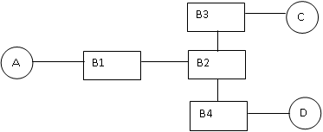
Problem 5
Problem:
  Consider the arrangement of learning bridges shown below. Assuming that all are initially empty, give the forwarding tables for each of the bridges B1-B4 after the following transmissions.
  (i) A sends to C, (ii) C sends to A, and (iii) D sends to C
EE4204/TEE4204 (Part 1) Tut 4
G.Mohan / NUS

Slide 9
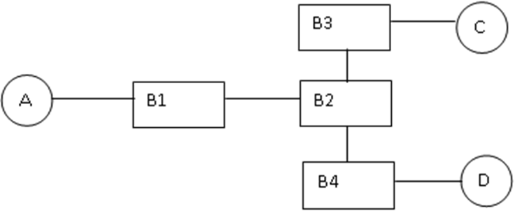
Problem 5 (Contd.)
Solution:
  (i)When A sends to C, every bridge forwards the packet through all the interfaces as none of the bridges knows where C is; all bridges learn where A is.
  (ii) When C sends to A, the packet uses the path C – B3 – B2 – B1 – A as every bridge knows where A is; Bridges B3, B2, and B1 learn where C is; Bridge B4 does not learn where C is.
  (iii)When D sends to C it uses the path D-B4-B2-B3-C. B4 sends the packet to B2 which forwards it to B3 which in turn forwards it to C; Bridges B4, B2, and B3 learn where D is; Bridge B1 does not learn where D is.
EE4204/TEE4204 (Part 1) Tut 4
G.Mohan / NUS

Slide 10
Problem 5 (Contd.)
Solution:
  The forwarding tables are built as follows:
  Bridge B1
  Bridge B2
Host | Port
A | B1 → A
C | B1 → B2
Host | Port
A | B2 → B1
C | B2 → B3
D | B2 → B4
EE4204/TEE4204 (Part 1) Tut 4
G.Mohan / NUS

Slide 11
Problem 5 (Contd.)
Solution:
  The forwarding tables are built as follows:
  Bridge B3
  Bridge B4
Host | Port
A | B3 → B2
C | B3 → C
D | B3 → B2
Host | Port
A | B4 → B2
D | B4 → D
EE4204/TEE4204 (Part 1) Tut 4
G.Mohan / NUS

Slide 12
Problem 6
Consider a wireless LAN with four nodes A, B, C, and D. Nodes <A,C> are within the communication reach of each other. Similar is the case for <A,B> and <C,D>. Suppose that A wants to send a frame to B, and C wants to send a frame to D. Describe the scenarios (cases of “communication reach” for other possible pairs of nodes) which could lead to a collision between the above two transmissions. Briefly explain how such a collision is avoided with MACA.
EE4204/TEE4204 (Part 1) Tut 4
G.Mohan / NUS

Slide 13
Problem 6 (Contd.)
Solution
  If B is within the reach of C or D is within the reach of A, collision will happen.
  With MACA, when a node sees a CTS frame, it does not attempt any transmission. In the above case, when C sees the CTS frame from B, it does not initiate a transmission. Similarly, when A sees a CTS frame from D, it does not initiate a transmission.
EE4204/TEE4204 (Part 1) Tut 4
G.Mohan / NUS

